Slide 1

INFO 442 · Data Science Projects
Understanding User Preferences through Latent Factors
Evaluating Matrix Factorization vs. Neighborhood-Based Collaborative Filtering on MovieLens 100K
CHANG LIU · BOLUN FENG · JIAJIN GUO · SHIXUAN LI
JUNE 2026
SLIDE 1 OF 11

Slide 2

BACKGROUND SCOPING
The Data Science Challenge: Information Overload
Streaming platforms curate massive catalogs, creating severe information overload for end consumers.
Key Catalyst: Over 80% of all video plays are driven directly by recommended pipelines on major networks.
Scientific Inquiry: Can low-rank latent factor representations outmatch standard localized neighbor metrics?
Hypothesis: Matrix Factorization maps sparsity (93.7%) better by compressing profiles into robust lower-dimensional spaces.
THE PROBLEM SCOPING
SLIDE 2 OF 11

Slide 3





RESEARCH ARTIFACTS
Data Overview & Project Pipeline
MovieLens 100K Profile
Execution Timeline
Parameter | Value / Attribute
Total Audited Users | 943 Active Consumers
Catalog Size | 1,682 Movies Index
Observations | 100,000 Verified Explicit Ratings
Sparsity Index | 93.7% Sparse Matrix
Evaluation Split | u1.base (80k Train) / u1.test (20k Test)
The pipeline strictly adhered to standard collaborative systems engineering steps from acquisition to benchmarking.
Scoping
Clean
EDA
Models
Deploy
DATASET & PIPELINE
SLIDE 3 OF 11

Slide 4
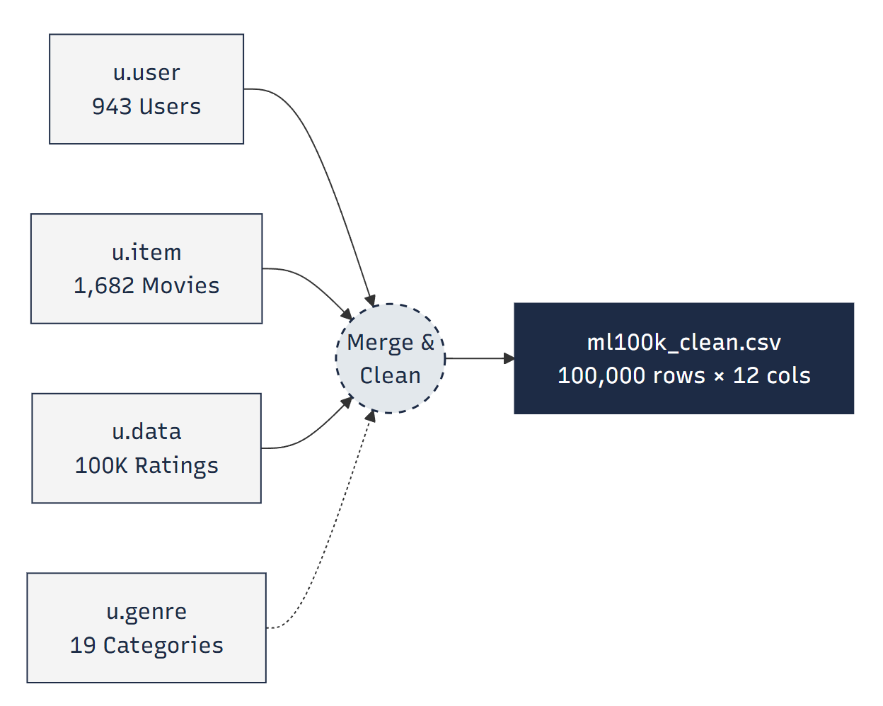
FEATURE ENGINEERING
From Raw Data to Clean Dataset
Consolidated relational schema entities (u.data, u.item, u.user, u.genre) to secure structural parity before training models.
Referential Integrity: Validated indices, confirming zero missing entries across user-movie joins.
Parity Check: Verified rating constraints ∈ [1, 5] bounds (0 records discarded).
Feature Augmentation: Appended rating_date (POSIX to datetime) and release_year.
Final Asset: Static exports in ml100k_clean.csv with minor missing values (<0.01% on release data,100,000 records × 12 engineered features)
DATA CLEANING
SLIDE 4 OF 11

Slide 5
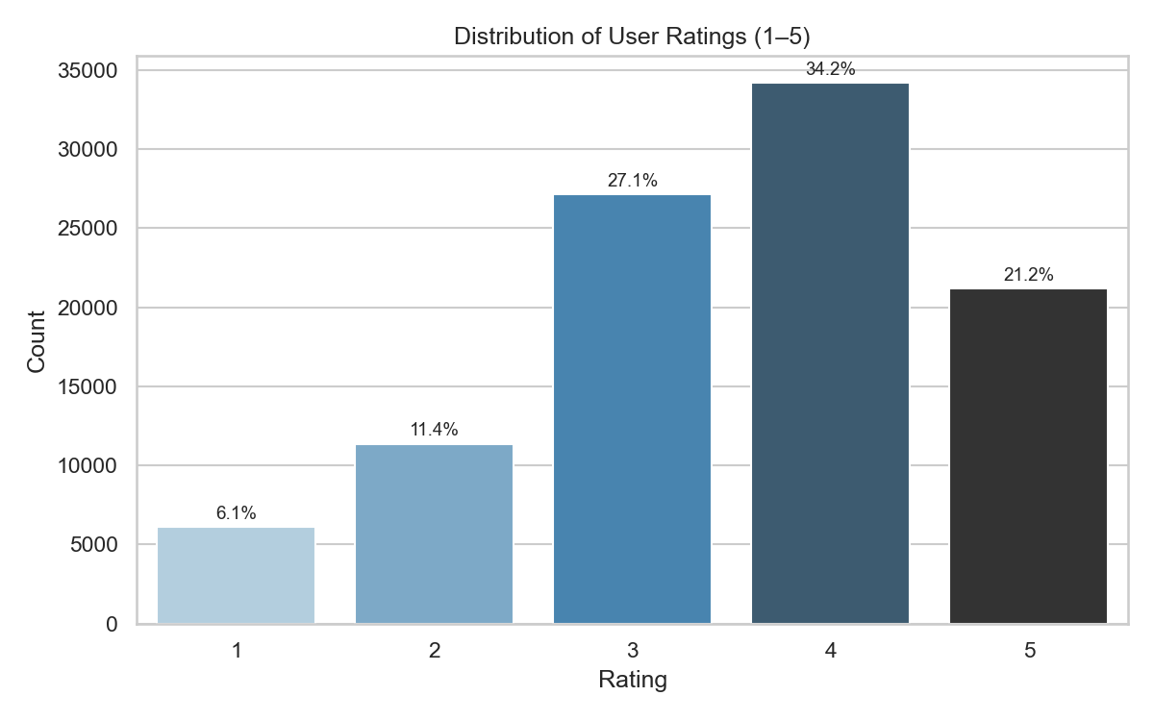
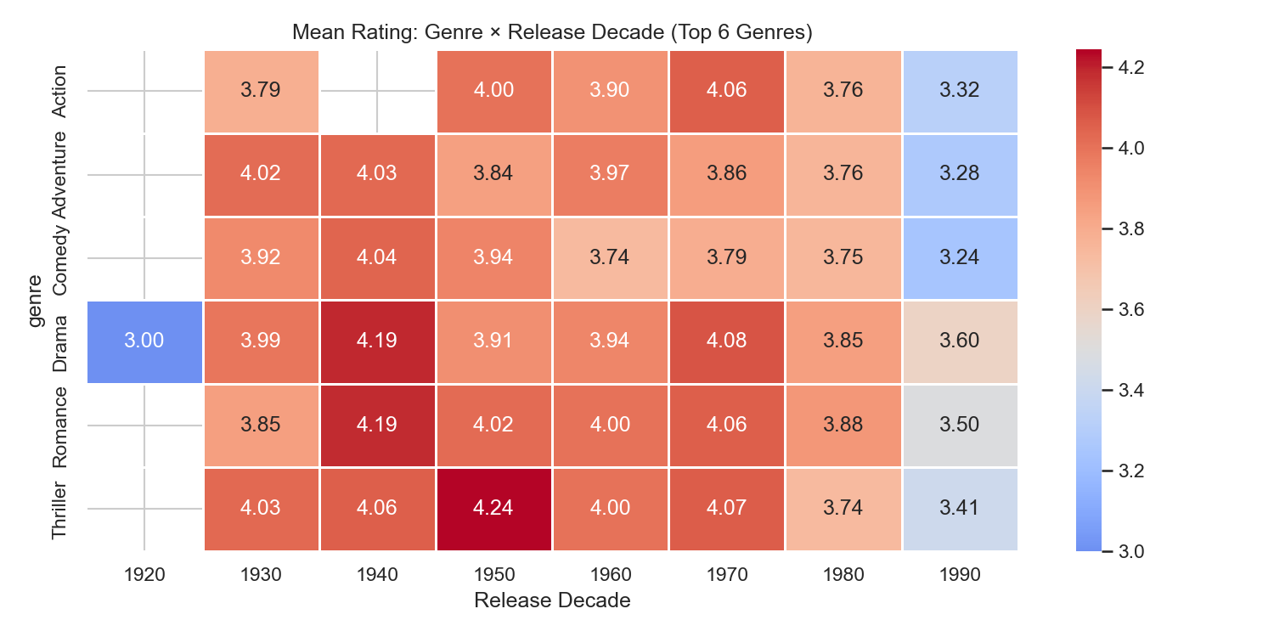

EXPLORATORY DATA ANALYSIS
Key EDA Findings (M4)
Rating Behavior & Demographics
Positive Skewness: High score concentration exists. Stars (4 & 5) comprise 55.4% of ratings, while 1-star ranks only 6.1%.
Central Tendency: Global baseline average stands high at 3.53.
Demographic Skew: Active reviewers center at 25 years old. 74% are male, and student jobs comprise 22% of total scores.
Key Hypothesis Shift: Older cohort targets score more generously. Classic movies score consistently higher than modern 1990s counterparts due to survival/nostalgia bias. Gender proved to have a marginally weak effect on ratings...
EXPLORATORY FINDINGS
SLIDE 5 OF 11

Slide 6
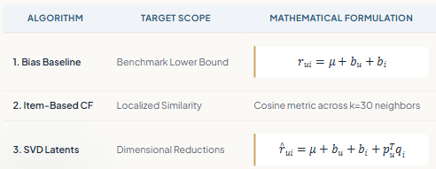

ARCHITECTURE DESIGN
Three Models, Two Evaluation Goals
Evaluation Targets
We test against two separate criteria families using a held-out test split:
Group A (Rating Error): Root Mean Squared Error (RMSE) & Mean Absolute Error (MAE).
Group B (Discovery List): Precision@10 & Recall@10 (evaluating items with score ≥ 4).
METHODOLOGICAL RATIONALE
SLIDE 6 OF 11

Slide 7
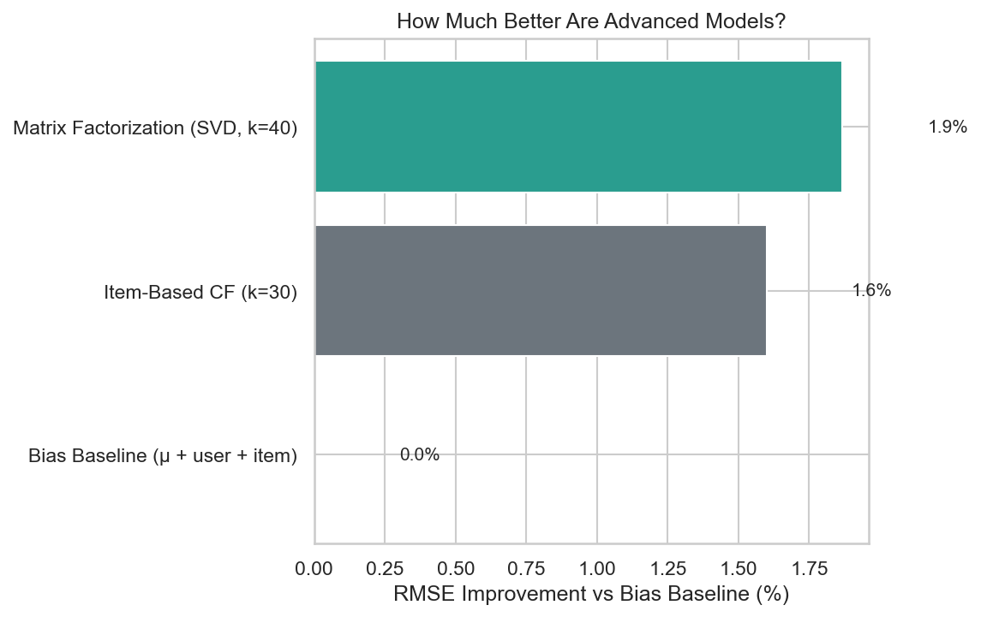



PERFORMANCE RESULTS
Results on u1.test (20,000 ratings)
Model Framework | RMSE↓ | MAE↓ | P@10↑ | R@10↑
Bias Baseline | 0.977 | 0.766 | 0.009 | 0.003
Item-Based CF (k=30) | 0.962 | 0.751 | 0.062 | 0.014
Matrix Factorization (k=40) | 0.959 | 0.750 | 0.025 | 0.008
SVD Accuracy Win
Item-CF List Win
Best RMSE score of 0.959 (-1.9% error over baseline), validating low-rank theory.
Precision@10 of 6.2% (2.5x increase over SVD) due to less conservative list mapping.
Prediction Behavior: All models exhibit conservative forecasting, compressing rating outputs toward the 3–4 star range.
BENCHMARKING METRICS
SLIDE 7 OF 11

Slide 8
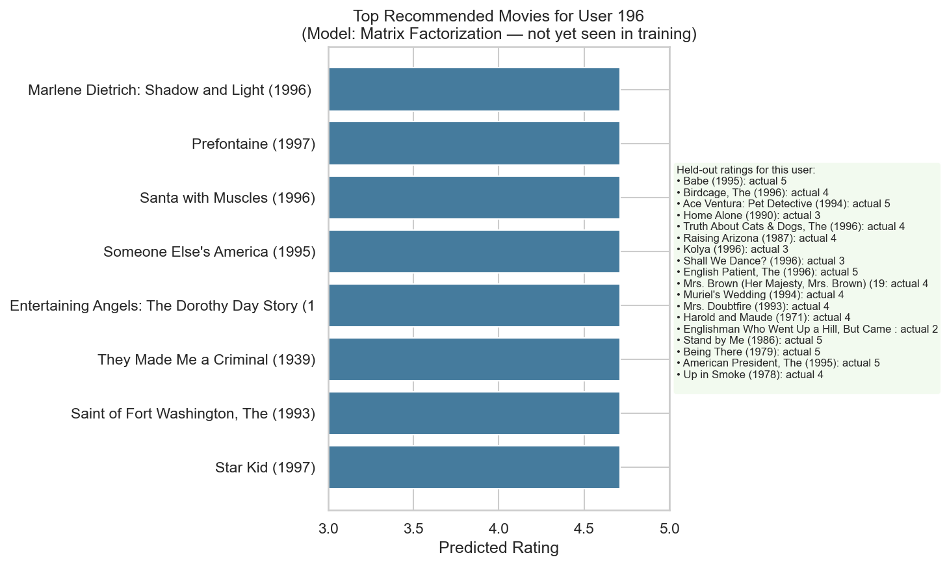
BUSINESS INTEGRATION
From Metrics to Product Decisions
Deployment Playbook
Commercial Goal | Best Model Selection | Rationale
Minimize rating prediction error | Matrix Factorization | Lowest RMSE score
Maximize playlist conversions | Item-Based CF | Highest Precision@10 list score
System explainability | Bias Baseline | Auditable user & item offsets
.
Engineers must match deployments to localized catalog requirements instead of declaring a single system 'winner'.
SYSTEM DEPLOYMENT STRATEGY
SLIDE 8 OF 11

Slide 9

EDGE CASE ANALYSIS
What Can Go Wrong (Failure Modes)
COLD-START PROBLEM
SYSTEM BIASES
New active profiles or fresh catalog entries without historical interaction indices bypass embeddings, forcing system fallbacks to global median values.
Demographic Imbalance: High skew towards young males (74%) leads to weaker recommendation signals for other cohorts.
Over-compression: Conservative behavior clusters scores around 3–4 stars, rendering 1-star forecasts highly inaccurate.
Evaluation Limits: Single fixed split (u1); robust confirmation requires k-fold Cross-Validation.
Solution: Popularity-based seeding is required during customer onboardings.
SYSTEM BOUNDARIES
SLIDE 9 OF 11

Slide 10






EXECUTION SUMMARY
Conclusion & Future Roadmap
End-to-End Pipeline: Delivered clean, reproducible engineering logic spanning ingest, custom data exploration, modeling, and deployment guides.
SVD Strengths: Latent structures reliably capture broad global ratings, while neighborhood architectures better preserve ranking metrics.
93.7%
SPARSITY SUCCESSFULLY RESOLVED
EDA Implications: Recognizing historical skews remains vital to prevent propagating popularity feedback loops.
Pipeline Ingest
SVD Latents
Evaluation
Hybrid Model
Fairness Audit
Cleaned raw tabular csv
Optimized 40 latent factors
Identified failure boundaries
Incorporate genre features
Correct demographic skew
SYNTHESIS
SLIDE 10 OF 11

Slide 11
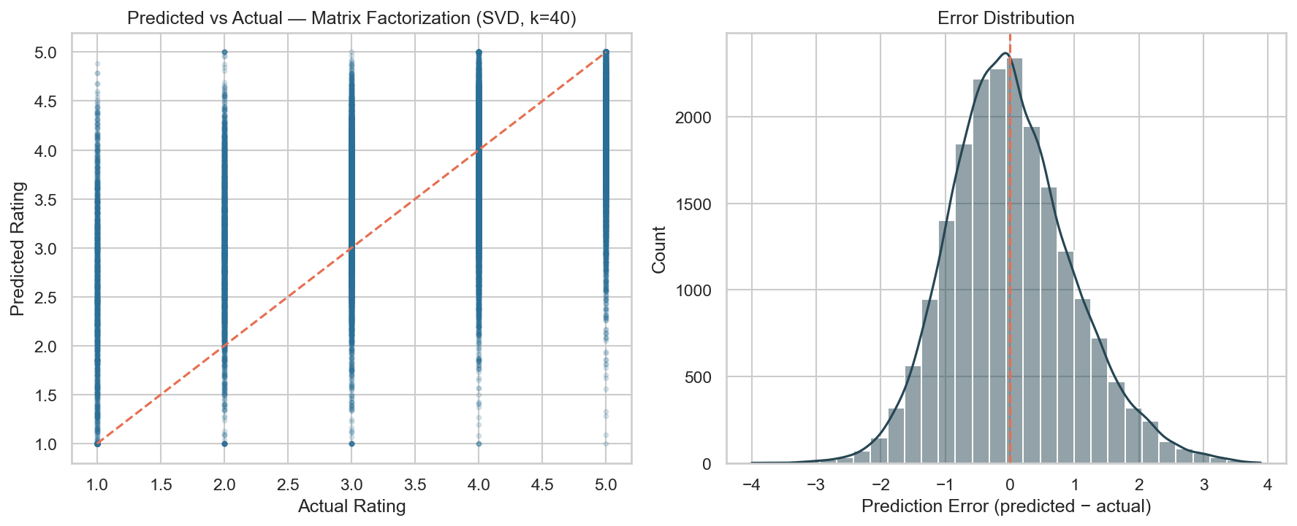
ACADEMIC APPENDIX
THANK YOU !
Model Diagnostics
Scientific Reference Card
Researcher | System Responsibility
李仕轩 (Lead) | Experimental setup & evaluative scoping
刘畅 | Pipeline ingest & exploratory findings
冯博伦 | Baseline development & similarity design
郭甲进 | SVD tuning & hyperparameter selection
Project Repository: https://github.com/36712/Data-Science-Projects
AUDITING & REFERENCES
SLIDE 11 OF 11

